Slide 1
Journey by Eagles
Dorobanțu Petruț
Cojocaru Dan
Ciobanu Laura
Szilard Ivacsony

Slide 2
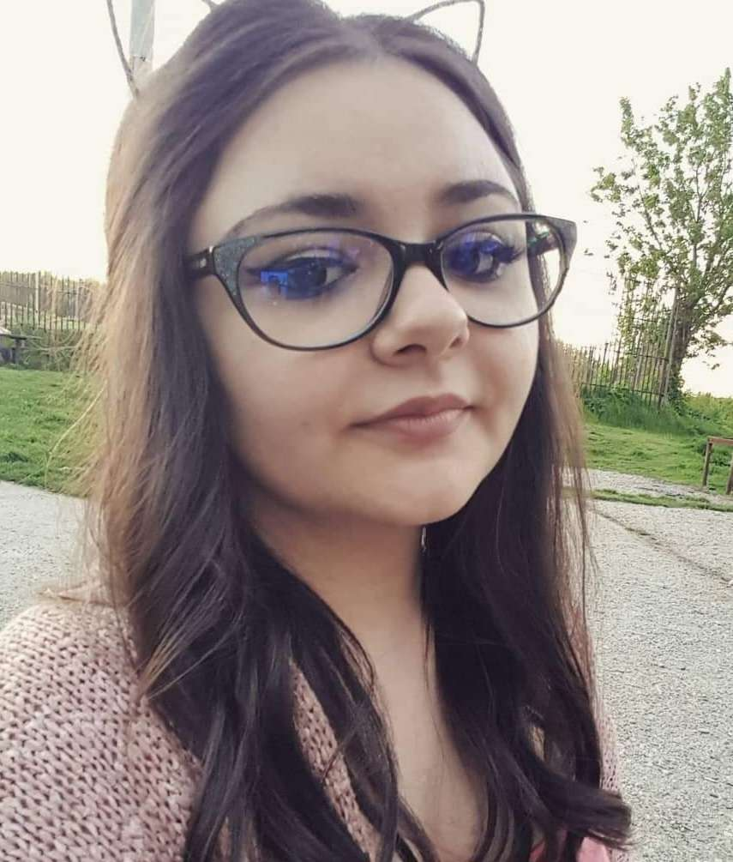
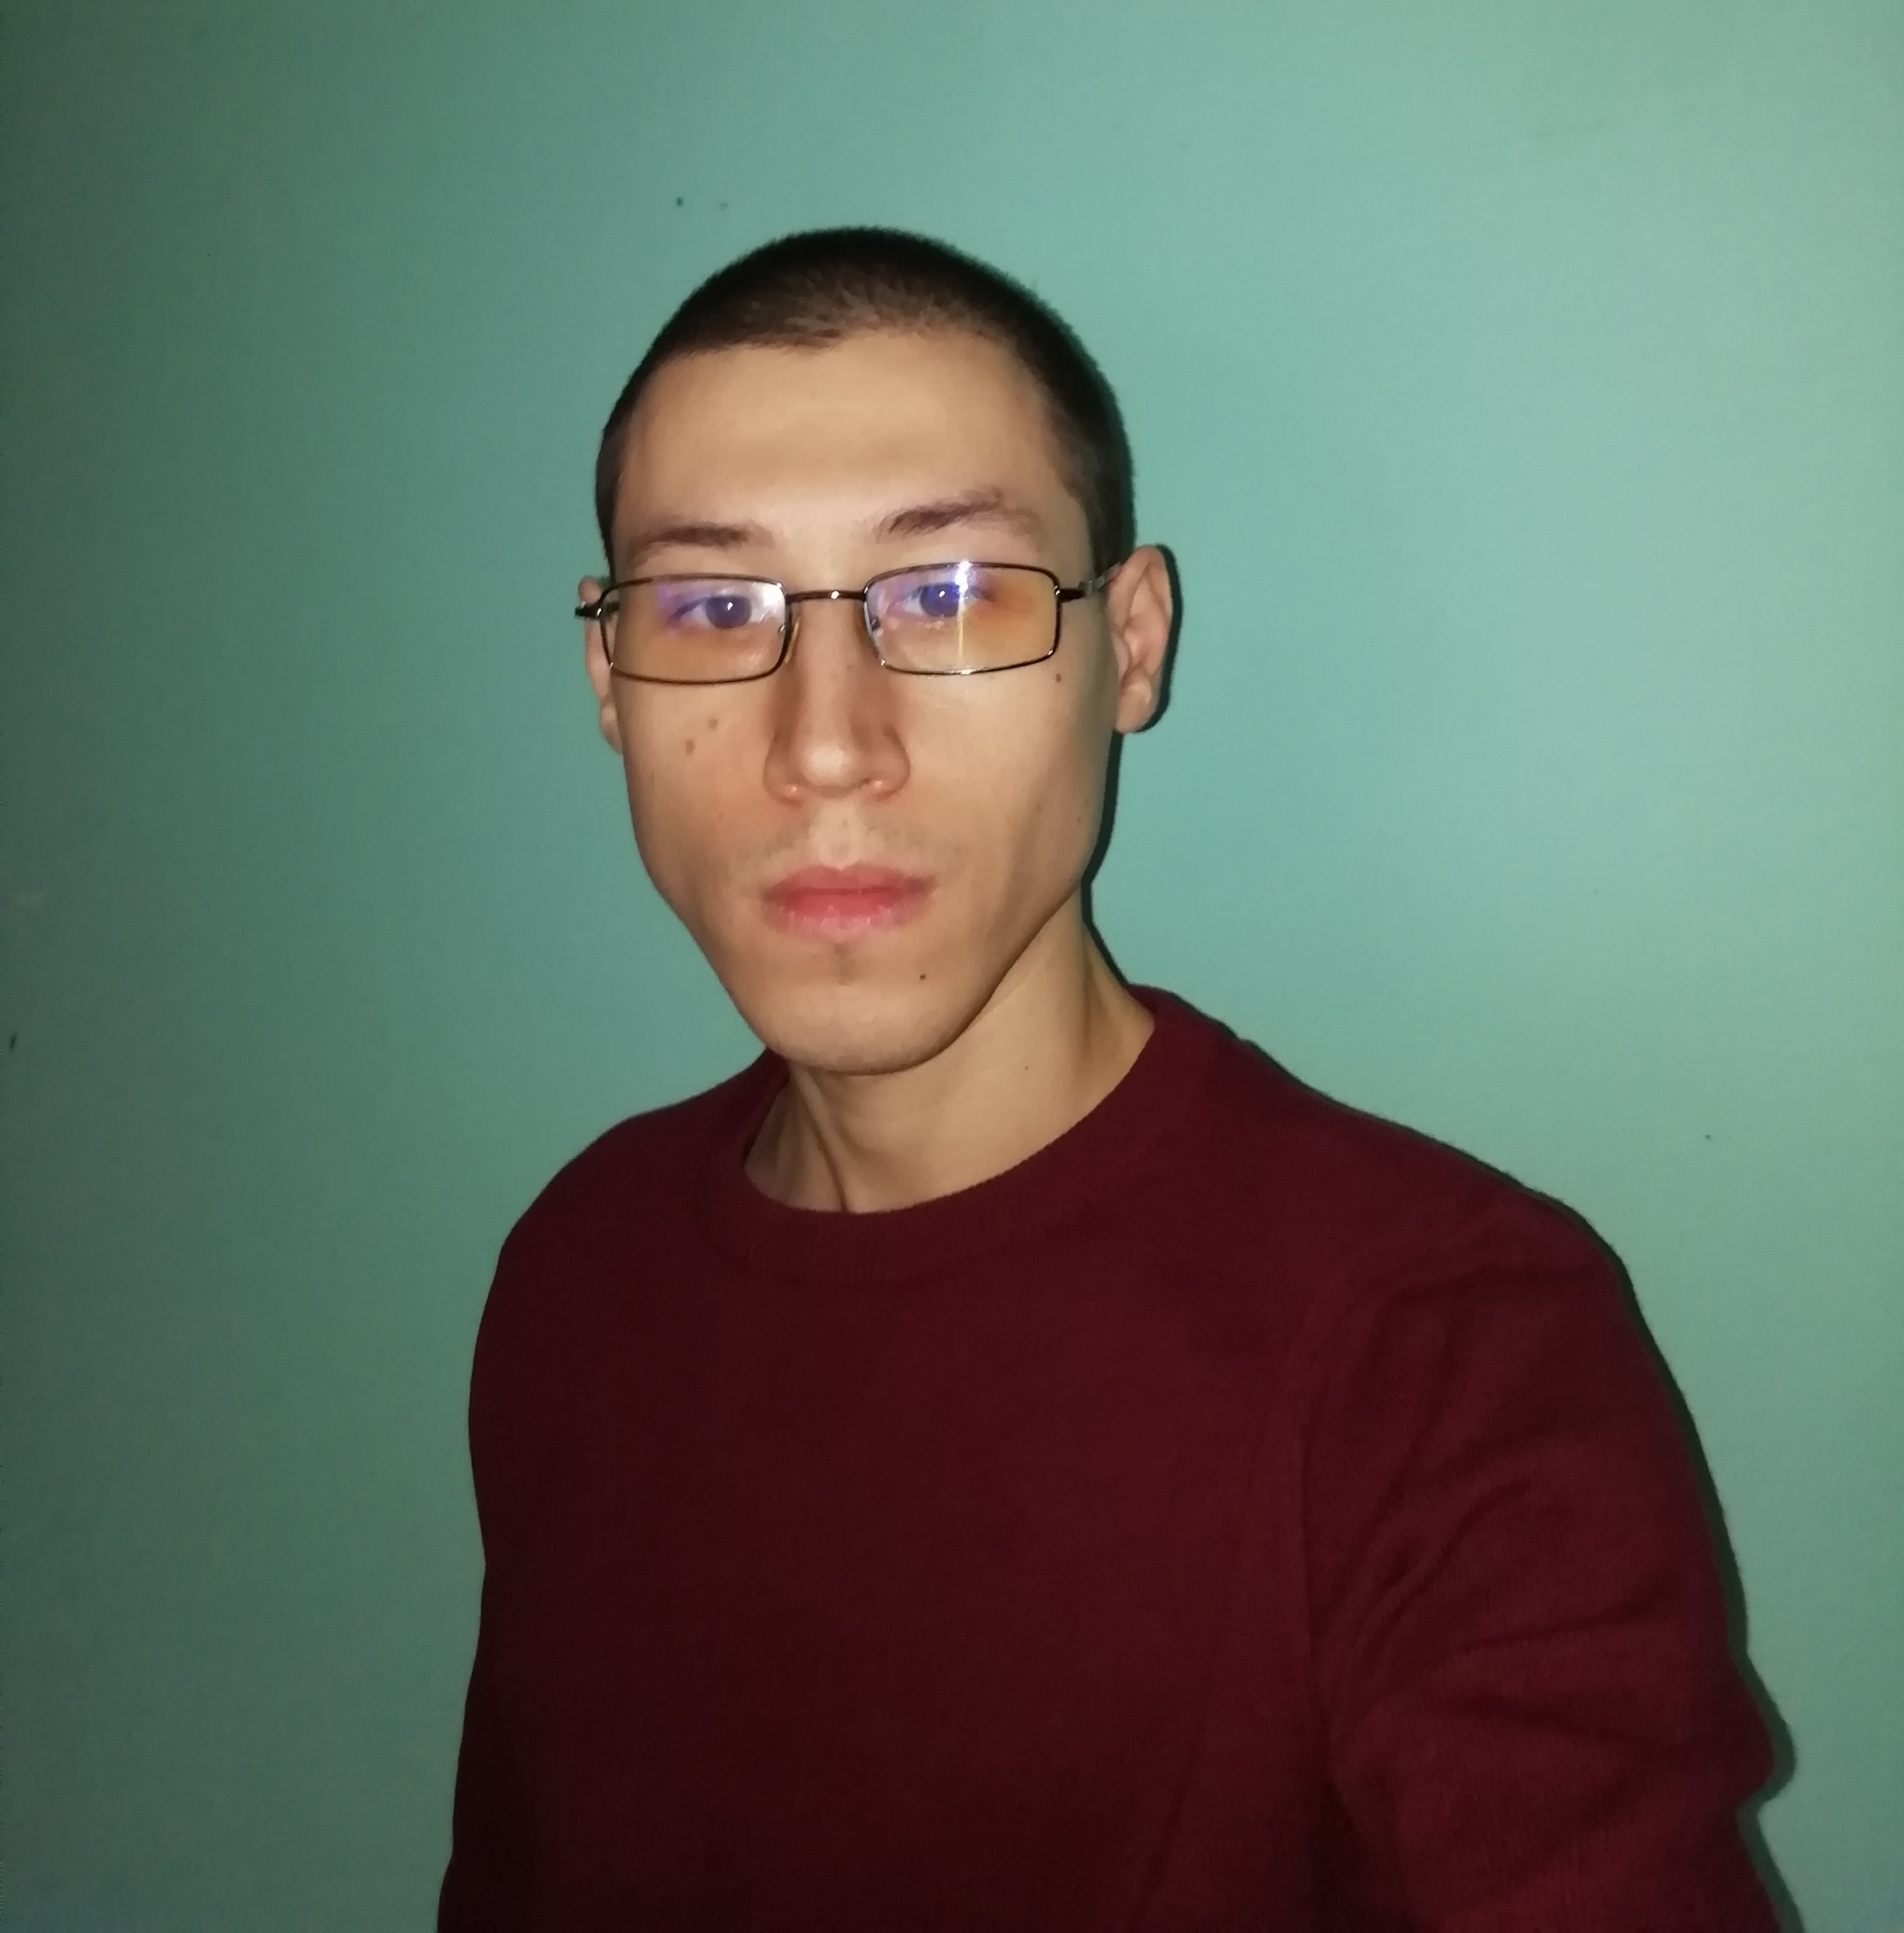
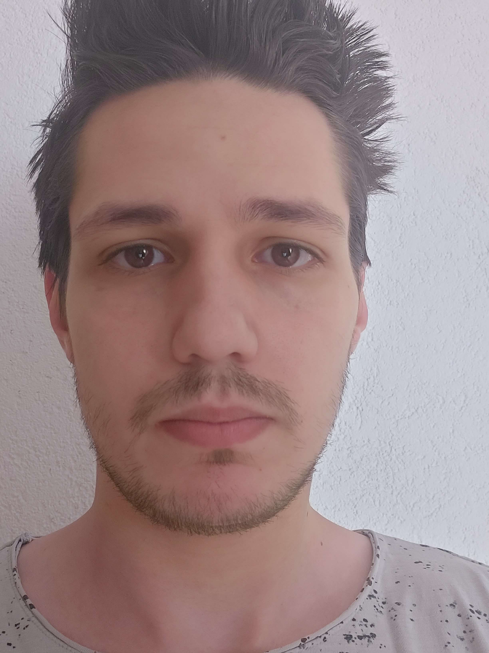
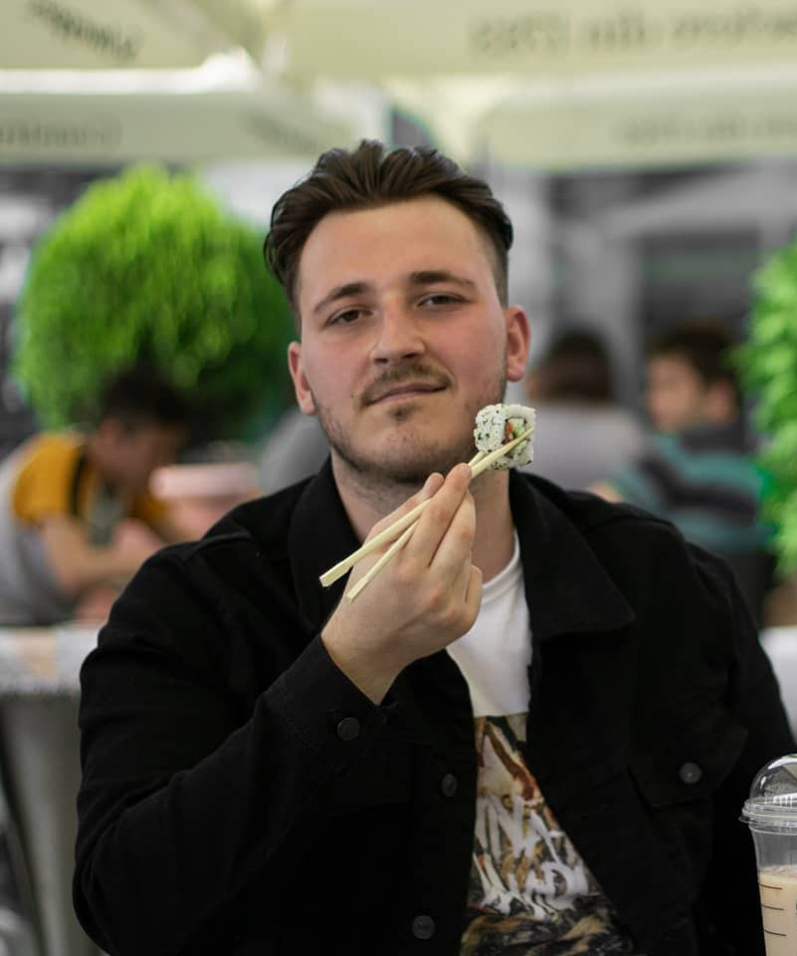
Team Members

Slide 3




Tehnologies and Tools

Slide 4



About project
Collect attendance ( ) to get 1 point
Collect mentor ( ) to get 10 points
Collect virus ( ) lose 1 heart
Movement:
“a” to
“d” to
Jump on “Space”

Slide 5

Timeline
Monday: We have received the teams' format and instructions for the project. We started the lessons on code.org.
Tuesday: We continued the lessons on code.org and had a meeting to share ideas on what we would like to implement. We also started working on the game.

Slide 6
Timeline
Wednesday: We finished the lessons on code.org and continued working on the game.
Thursday: Added some finishing touches and created the presentation.

Slide 7

What we learned/Challenges we faced
During the project, we learned the basic principles of JavaScript and got accommodated to the tools used. We had the opportunity to work in a team and practice our communication and social skills.
The challenges we faced during this project were organizing our ideas into clear tasks and defining a structure.

Slide 8
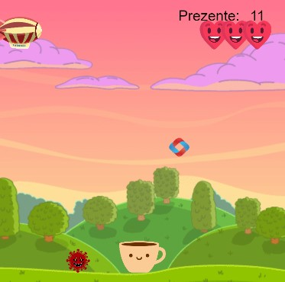
Demo

